Slide 1
TAC Sports Group Training -Module 3
Coaching Mastery

Slide 2
Mission of TAC Sports Group Coaches
The mission of all TAC Sports Group Coaches is building and developing the confidence and skills of the next generation, helping it to be more equipped to thrive in the world, through active participation and education

Slide 3
What makes a Master Coach
Take advantage of the resources available at TAC Sports Training Centre
Attend and participate actively in the corresponding seasonal training
Use, understand and follow the daily programming provided
Create and implement lesson plans that are adaptable to changes and different levels of skill
Count on and become part of our supportive staff network
Know and utilize the 5 Star Development Map

Slide 4
Objectives of a Master Coach
To increase the participation and enjoyment of children in each activity
To provide constructive feedback
To create positive connections with campers/students
To demonstrate and reinforce leadership skills
Master Coaches achieve success through maximizing participation and growth of all Students.
Students will gain, Skill, Confidence, Independence and continue their journey of Self-Mastery with each repetition they are actively coached through.

Slide 5
TRAINING CENTER
WWW.TACSPORTS.CA/TRAINING
Mobile Friendly - Save to your phone
Goal: To provide coaches with full support system and resources to build great lesson plans

Slide 6
Coaching Mastery Programming
3.1-Programming Theory
E.G.G.S Principles
Explain and Demonstrate
Group Practice
Group Feedback
Specific Practice and Feedback
Laws of Coaching
Genuine Concern
Identity and Self Image Enhancement
Attention in Movement
Frequency
Energy Transfer
3.2 Practical Programming
5 Star Development Map
Building Progressions
Providing Feedback
Adventure Camp Programming
Adventure Camp Manual
Adventure Camp Booklet
Sport Specific Programming
Low Organizational Games
Accuracy, Speed, Pressure

Slide 7
Programming Theory
Module 3.1

Slide 8
Teaching Standards - E.G.G.S Principles
We use the “EGGS” principle as our fundamental core strategy to introduce a new skill or drill to each class. For each progression, the principle should be applied to each step, no matter the difficulty level.
Explain & Demonstrate
2. Group Practice
3. Group Feedback & Correction
4. Specific Feedback & Correction

Slide 9
E.G.G.S Principle - Explain and Demonstrate
Explain & Demonstrate
Keep your instructions short and specific. Most children are not auditory learners and prefer visual cues rather than talking at them. Demonstrate PROPERLY the skill you would like to see and with all the must sees. For example, for a front float – show a starfish on front, body horizontal, face in the water, and bubbles being blown. Hold for the amount of time required. If teaching with an assistant instructor, have them demonstrate as you explain. If no assistant is available, make sure to swim across the class rather than away from them. For example:
X →
xxxxxx

Slide 10
E.G.G.S Principle - Group Practice
Group Practice
Keep your group moving! The more practice the better! Have more than one camper go at once to maximize the amount of practice time and minimizing the amount campers standing doing nothing. They will get restless and/or bored if they do! Be sure to constantly scan the entire class while they are practicing.
X
↑ ↑
xxxxx

Slide 11
E.G.G.S Principle - Group Feedback & Correction
Group Feedback & Correction
After completing a skill as a group, give all your campers “general feedback and corrections” as a group, instead of signalling them out individually. “Assume I am talking to you,” type of feedback. Then, give them the opportunity to reinforce this by more practice. For example:
“Good job guys! Now let’s all work on keeping our toes pointed while kicking and hips and bellies up to the sky”

Slide 12
E.G.G.S Principle - Specific Feedback & Correction
Specific Feedback & Correction
During turns of practicing after group feedback and correction has been completed, you can now provide each swimmer with more specific corrections of what they need to work on. Do this while the rest are practicing so they do not feel under pressure with others watching. Begin with the most serious correction first! Most swimmers can not correct multiple things at once, as it is overwhelming. Pick one area and begin there. For example:
“Great job! Now I want you to really focus on keeping your belly and hips up the to sky the whole time”

Slide 13
Laws of Coaching
Genuine Concern
2. Identity Formation and Self Image Enhancement
3. Attention In Movement
4. Frequency
5. Energy Transfer

Slide 14
Law of Genuine Concern
The Law of Genuine Concern is the law that we genuinely want our students to succeed. This
changes the session to an intense demand of time, trying to fit every bit of repetition and
feedback points as possible for maximum improvement.
Mentality : This is best described as desperately wanting your students to get the highest
number of repetitions in as possible in order to improve themselves.
You want each and every student to maximize your development and you are emotionally
invested and concerned in their development.
It is what brings urgency and excitement to each of your training sessions, and what makes
you think of how you can help them further after the session as well.
We have tons of opportunities for them to further development, and as a coach, you want to
make sure they succeed in LIFE

Slide 15
Identity Re-Affirmation and Self-Image Enhancement
NAME, NAME and NAME
Learn the names of your students, and repeat it often! This is the fundamental principle of coaching. In order to connect with a student and open their mind to learning, you must connect on the name basis.
IDENTITY FORMATION AND SETTING EXPECTATIONS
The key influence changing the identity of your students comes from setting a standard set of expectations. People will form to your expectations with the proper guidance and reinforcement.
DISCIPLINE
Students will treat you and the session as you allow them to. Set the expectations that the session is very important and that your time is very important. Set the expectation that their time is important, and the money they spent on the session.
Anyone who is continuously acting up set the expectation that they are a leader and make them your co-captain. If all else fails, remove them from the session to set the tone that the session is very important.

Slide 16
Law of Attention in Movement
The human body releases hormones through neurotransmitters in response to certain stimulus, allowing people to experience an array of emotions; It is important to understand how release of hormones are triggered and how we can maximize the physical and mental benefits benefits provided.
Endorphins - Set a challenge and have them overcome it to release endorphins
Oxytocin - Learning the name, giving high fives and hugs and giving them respect releases oxytocin.
Dopamine - Celebrating and being funny and passionate releases dopamine in the brain. Dopamine is the neural regulator of the brain and gets released with exercise.
Norepinephrine and Adrenaline - Keeping the sessions intense with time-based point scores and challenges helps to release adrenaline, causing students to be more alert, excited about the session, and attentive
Serotonin - Released through movement, it is especially important to have our campersmoving at all time.

Slide 17
Law of Frequency
All people who are successful in the respective field have practiced and trained the foundational skills required to be successful numerous times correctly.
The successful completion of foundational skills, and amount of repetitions the skill is repeated correctly, determines their ability to execute the skill at a high level.
To be considered to be a master of a skill you must complete 9,000 hours of training
Our goals is to provide campers with this knowledge, and provide them with the proper demonstration of the skill, and correct and deficiencies they may have while executing the skill

Slide 18
Energy Transfer
The energy and passion transmitted through vocal tone, body language and your excitement will transfer to your students.
As socially influential human beings, we reflect the energy and the passion of others
As a coach and leader, you can transfer that energy into the session.
Use of fun and comedy
Ensure to keep the session light, crack jokes and be a bit silly. Campers thrive in an environment they feel comfortable joking around and being themselves without fear of judgement. Laughter is the best way to unite a group of people
You also keep the positive chemicals flowing through the release when they laugh. Comedy is a bonding tool socially, and oxytocin (the bonding positive neurotransmitter)is released when you make a child laugh.

Slide 19
Practical Programming
Module 3.2

Slide 20
5-Star Development Map
Our 5-Star Development System helps teach campers 50 skills mastered by successful athletes. Each camper will go home with a 5-Star Development Map noting which skills were worked on during the week of camp
While teaching campers skills on the 5-Star Development Map, quality of repetition is the primary focus.
Campers are challenged to perform skills with a high level of accuracy, at a faster speed, and with an increase of pressure
Throughout the camp, campers are encouraged to count the number of quality of repetitions
Quantifying campers development helps campers understand how they can develop their skills to the best of their ability.
5-Star Development Maps should be referenced each day of camp

Slide 21
5-Star Development Map - Master Coaches
Master Coaches present the 5-Star Development Map in a manner which creates excitement within campers and educates campers on the necessary skills to be successful in their sport.
Highlighting a superstar athlete that excels at the skill will help campers visualize the skill being executed following the criteria of our performance indicators.
Campers can then model their actions after the referenced player
Coaches should celebrate the successful execution of a skill no matter how simple the skill seems.
Positive reinforcement and constant encouragement will create a positive connection between, coaches and campers, and the camper and the skill they are practicing

Slide 22
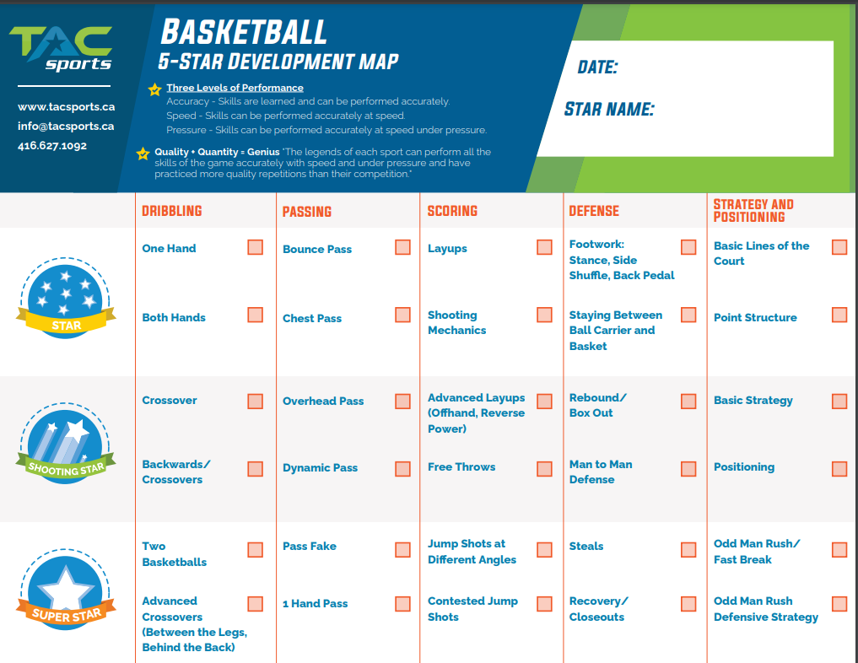
5-Star Development Map - Skill Progression
Performance Indicators:
Accuracy
Speed
Pressure
5-Star Development Maps are separated into sections of skill sets. Skills are listed from top to bottom, with the most difficult skills place at the bottom of the page.
Skills at the top of the Map are basic movements to build more difficult skills from.
Each skill underneath a skill is to be taught from the base skill using progressions.
As campers and groups show they are able to perform skills accurately, camper will be taught high performance skills.

Slide 23
5-Star Development Map - End of Week Awards
While completing 5-Star Development Map’s Coaches will need to select an award for each camper in their group. The awards should be a reflection of the campers performance throughout the week.

Slide 24
5-Star Development Map - Skill Progression
Using the basketball 5-Star Development as an example for the progression of skills; Bounce passes are taught by:
Introducing a secure grip on the ball.
Campers then step forward with one foot
While pushing the ball to the ground from their chest to the halfway point between the passer and the target.
Hand must follow through wrists and thumbs should be pointing towards the ground
Campers receiving the ball must extend their arms and have their hands ready to receive the ball.
From this basic movement and skill, campers can begin to build accuracy, increase speed and face pressure. These are the key moments to introduce challenges and new progressions of the immediate skill ie; distance, defender, moving targets etc

Slide 25
5-Star Development Map - Skill Progression
In order for a player to be well rounded and perform the skill at a high quality they must be challenged with progressions. Skills which are more difficult can be taught from the basic movements of the previous skill, without the previous skill being mastered at a high intensity.
Chest passes follow the same footwork as bounce passes
The ball must still come from the passers chest and hands must the ball through their wrists with thumbs pointed towards the ball
Campers may struggle to push the ball the distance needed to pass the ball to their partner
Proper form should be emphasized to perform skill accurately
Strength building exercises can be programmed into lesson plans

Slide 26
5-Star Development Map - Skill Progression
As campers progress through skills down the 5-Star Development map previous skills be fine tuned and still practiced.
To ensure engagement, create games, challenges, or friendly competitions that allow everyone to participate and practice the skill with accuracy.
If you would like to increase the intensity of the drill, it would be wise to have campers compete against themselves. By doing so, we can acknowledge everyone's successes and keep the atmosphere of a fun, inclusive environment for all skill levels.

Slide 27
5-Star Development Map - Providing Feedback
When providing constructive feedback to campers during sessions it is best to use the ‘Sandwich Method’:
Start with a positive comment
Provide the constructive feedback to help camper perform the skill to a higher level of quality
Finish with another positive comment
By following this process, campers will not feel discouraged by the feedback and will build a positive relationship with receiving feedback.

Slide 28
5-Star Development Map - Providing Feedback
All coaches are encouraged to provide feedback to as many parents/guardians as possible. The ‘Sandwich Method’ should still be used, coaches should use the 5-Star Development Map to help provide visual of the skills being taught. When speaking with parents/guardians coaches must;
Introduce themselves and learn the names of the parents/guardians
Include campers in the conversation
Use both campers and parents/guardians names
Allow parents/guardians and campers an opportunity to provide feedback of the camp

Slide 29
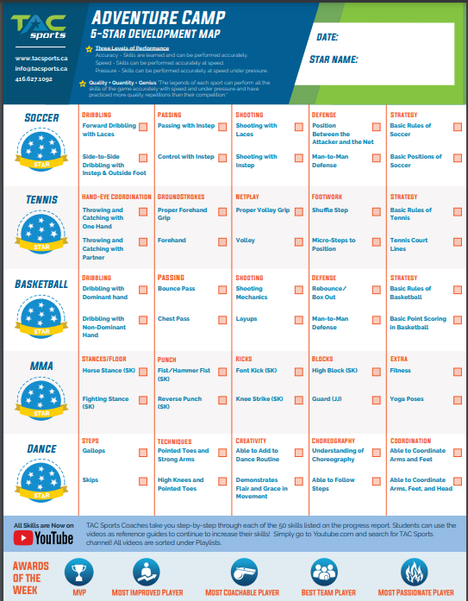
Adventure Camp
5-Star Development Map
Adventure Camp’s 5-Star Development Map introduces the 10 most practical skills and concepts for campers to learn to be successful in the sport as a beginner.

Slide 30
Adventure Camp - Programming Basics
Adventure camp (3.5 - 6 years old) provides an opportunity for campers to explore dexterity, learn the basic movements and rules of sports, and socialize in an active environment.
Each day, adventure campers will learn and practice skills of 3-4 sports, combines with spaces for relaxation and arts
All activities are planned with no lines to maximize participation and repetitions
Creativity is encouraged to entertain and help campers use their imagination while playing
Following themes of the day, campers can be take on ‘adventures’ while learning new skills
Campers have the option to participate in our ‘Learn to Bike Program’

Slide 31
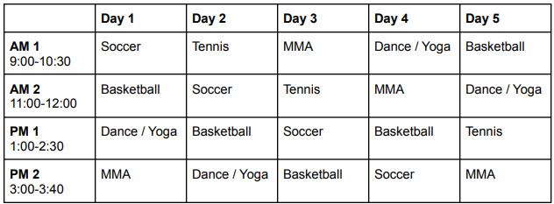
Adventure Camp - Daily Programming
Adventure Camp Coordinators or Coordinators will share a schedule to be followed by adventure camp groups throughout the week. The image below is a template to use as reference.

Slide 32
Adventure Camp Manual
The Adventure Camp Manual walks Coaches through the process of working as an Adventure Camp Coach. The manual contains:
Introduction of yourself and each camper in the group
How to set rules and boundaries - S.T.A.R.S.
Circle and Icebreaker games
A breakdown of how to teach skills of the core sports
Games to help campers practice skills being learned in a fun manner

Slide 33
Adventure Camp Booklet
Adventure Camp Booklets are designed to supplement daily programming as a low energy activity and creative outlet for campers to express themselves while learning about sports.
Each Camper will go home at the end of the week with the Adventure Camp Booklet they work on while attending camp.
Best used in down time between snacks, lunches and programming.

Slide 34
Learn to Bike Programming
Learn to Bike programming is geared to equip campers with the skills, confidence and knowledge to ride their bike independently, without the use of aids.
Campers are taught the basics; balancing, starting and stopping their bikes.
The introduction of navigation through obstacle courses prepares campers to ride their bike in public areas
Road safety, hand signals and general safety are taught to students to ensure their safety while riding their bikes
Campers will experience riding their bikes on different terrains to help increase the difficulty and prepare them for a realistic riding experience.

Slide 35
Activity Specific - Programming Basics
Activity Specific Programs (Ages 7 - 12 years old) will be introduced the basics of the activities while developing their practical skills, confidence and leadership skills to help them to progress through the more challenging skills of the chosen activity.
Programming Schedules reinforce this methodology by introducing simpler skills at the beginning of the week and allowing for coaches to add in progressions to engage every campers skill level.
Activity Specific Programs include:
Soccer
Basketball
Tennis
Dance and Gymnastics
Swimming
Volleyball
Activity Specific Programs include:
Coding
3D Design
Lego Robotics
STEM
Eco-Guardians
Chess

Slide 36
Daily Programming
Daily Programming Schedules will be provided for each activity.
Daily Programming Schedules are to be used as a guide for what skills to teach throughout the week
Group interests, abilities and availability of space will create flexibility within the Daily Programming Schedule
Coaches are responsible for preparing activities and games to teach and develop the skills

Slide 37
Low Organizational Games
The Low Organizational Games Handbook is a useful resource to help Coaches build lesson plan activities from or to use as back up games if planned activities end earlier than expected. The Low Organizational Games Handbook can be accessed at tacsports.ca/training
Contains games for different levels of energy exertion
Sport specific sections allow coaches to access games based on sport
Rules of the games are provided in detail
The games can be modified easily to fit the sport or abilities of the group

Slide 38
Accuracy, Speed, Pressure
While teaching Daily Programming Coaches should focus on the 3 performance indicators
Accuracy - Skill is taught to be performed accurately
Speed - Skill is performed accurately at increased speeds
Pressure - Skill is performed accurately under pressure
High Intensity drills or games will provide campers an opportunity to perform skills accurately, at speed, while facing pressure.

Slide 39
Group Development
Within activity specific groups the skill range, age and overall interest in the activity will vary between participants.
Coaches should be aware of the dynamic these ranges will create
Activities should be adjusted according to allow everyone an opportunity to participate, be challenged and have fun
Master Coaches will be able to find a balance between the subgroups and cater to the diverse needs of everyone
Utilizing progressions, all inclusive games and child-led activities are essential to maintaining this balance
Splitting the group by skill will assist in challenging everyone and ensuring all are practicing appropriate levels of skills, group activities and reinforcing the idea of one cohesive group is of utmost importance.
All students progress along the 5- Star Development System and get a 5-Star Development Map at the end of class

Slide 40
Lesson Plans
Following the Daily Programming Schedule with adaptable games and drills to engage campers of all skill levels will ensure Master Coaches Deliver on our expected programming outcomes

Slide 41
Conclusion
The culmination of programming theory, practical programming, executing on expected responsibilities and bringing a positive attitude will result in a successful program for all campers involved.
It is important to be prepared and understand the principles of teaching we try to instill in our coaches.
The in person training sessions will help you develop these principles and better understand how to teach activities to a group.
Module 3 Test

