Slide 1
TAC Sports Group Training Module 5
Human Resources Information

Slide 2
Human Resources Information
Status of employment
Uniforms
Training
Time off
Payroll
Use of Cell Phones
Contacts

Slide 3
Contractor or Employee?
Please read the below summary for further understanding of your status of employment
Everyone hired for Summer Camps will be deducted employment taxes (CPP, EI, and Federal Taxes) per government regulations unless you are hired as a contractor.
As an employee, you will receive a T4 for your income including tax deductions by the government.
All Staff who continue to work past the Summer Camp Season will not be deducted taxes, and it's the person's responsibility to report their income at the end of the year and submit a T4A (info here).
T4 - Employee
T4A - Contractor
Read about the difference here

Slide 4
Uniforms
TAC Sports Group will deduct $30 for 2 T-shirts for all coaches. All extra shirts will be $15. Academy Uniforms fees will be sent via directors. Uniforms will be deducted from pay.
All staff must meet the uniform requirements as listed:
TAC Provided Shirt
Must be visible
Appropriate footwear for activity
Appropriate legwear
Swimsuit for all aquatics staff
Athletic wear for all activity coaches
Black Pants or Athletic wear for LSA Staff
Whistle
Pen

Slide 5
Training
For Summer Camp 2023, our training payment format will be changed to the following:
Summer Camp Training will consist of 5 separate training dates, the completion of all 5 required training dates and online Modules will be compensated at $200 total.
To receive payment for your training, a minimum of two shifts (two school programs or two lessons) or one week of camp (whichever is more applicable) must be completed. Attending training and not completing a shift would mean training is not paid.
If you attend more than one Program-Specific Training you will be compensated following the terms in your contract (Training sessions are paid at the flat rate of $50 if in-person training sessions exceed 3 hours. To receive payment for your training, a minimum of two shifts (two school programs or two lessons) or one week of camp (whichever is more applicable) must be completed. Attending training and not completing a shift would mean training is not paid).

Slide 6
Time Off Requests & Sickness
All staff must submit time off requests by emailing hr.tacsports@gmail.com and CC’ing their Manager and/or Director. Time off requests is approved by Directors and are not guaranteed to be granted. As stated in your contract, there are blackout dates/months you can not request time off (Summer Camps from June 1st to the first of September).
Sickness - Sickness can happen, please let us know as far in advance if you think you will be sick. Only reasonable sickness is tolerated.
At least 24 hours advance notice.
Doctors note must accompany sick-leave.

Slide 7
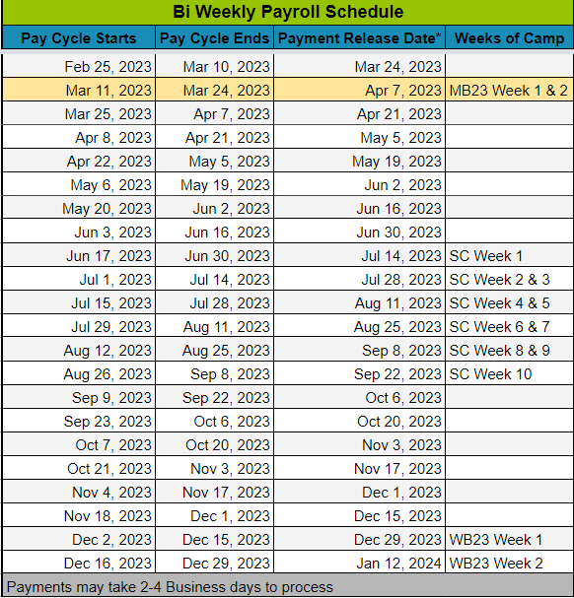
Payroll Information
Payroll is processed following the the paycle seen in the in the image.
In order to be paid you must complete the Payroll Form sent in the onboarding email.
If any of the banking information is incorrect a member of the payroll team will reach out to you
Payments may take 2 - 4 business days to process from our account and into your account.
Your patience is appreciated.
All inquiries related to payroll are to be directed to paytacsports@gmail.com

Slide 8
Cell Phone Use Policy
Cell phones are not to be used for personal matters unless there is a family emergency or you are on your break. Appropriate use of cell phones at camps are:
For quickly reporting and communicating important information pertaining to camp
If you are sending anything on cell phone, tell your assistant coach that you are sending a Google Space update
Posting pictures as requested
May be needed for incidents and reference for later use
Identifying campers with allergies or special accommodations
Pictures taken of campers should be done so discreetly and should not be posted anywhere other than the predetermined channels of communication
Reviewing lesson plans, attendance lists, lunch lists or information posted by staff
If you are caught using your cellphone for personal matters, you will be issued a warning by coordinators or other full time staff.
Should you continue to use your cellphone against the outlined reasons above, you will be sent home immediately and will undergo a performance review with a Director or Full Time Staff Member

Slide 9
Contact information
Directors & Full Time Staff
Adib Razavi - adib@tacsports.ca
Director of Operations & Cofounder
Alexander Arthur - alex@tacsports.ca
Director of Operations & Cofounder
Jessica Abreu - jessica@tacsports.ca
Director of Administration
Nik Collett - nik@tacsports.ca
Director of Outreach, Recruitment, Placements and After School Programs
Tyrone Stephenson - tyrone@tacsports.ca
Director of Basketball
Caleb Nunes - caleb@tacsports.ca
Aquatics Program Coordinator, Operations Manager and HR Manager
Ronald Hollingsworth - ronald@tacsports.ca
Program Coordinator & Equipment Manager
Cierra Phillips - cierra@tacsports.ca
Executive Administrative Assistant
Ihor Holovatin - info@lsacademy.ca
LSA Program Manager
Time off Requests & Formal Inquires
hr.tacsports@gmail.com
CC Directors, Managers you report to and Coordinators
Payroll
paytacsports@gmail.com

Slide 10
Conclusion
Our goal is to support our staff in delivering life changing experiences to campers, provide opportunities for growth and development, and help you achieve your goals.
Please let us know how we can better support you, our staff and campers; hr.tacsports@gmail.com
Module 5 Test

